Slide 1
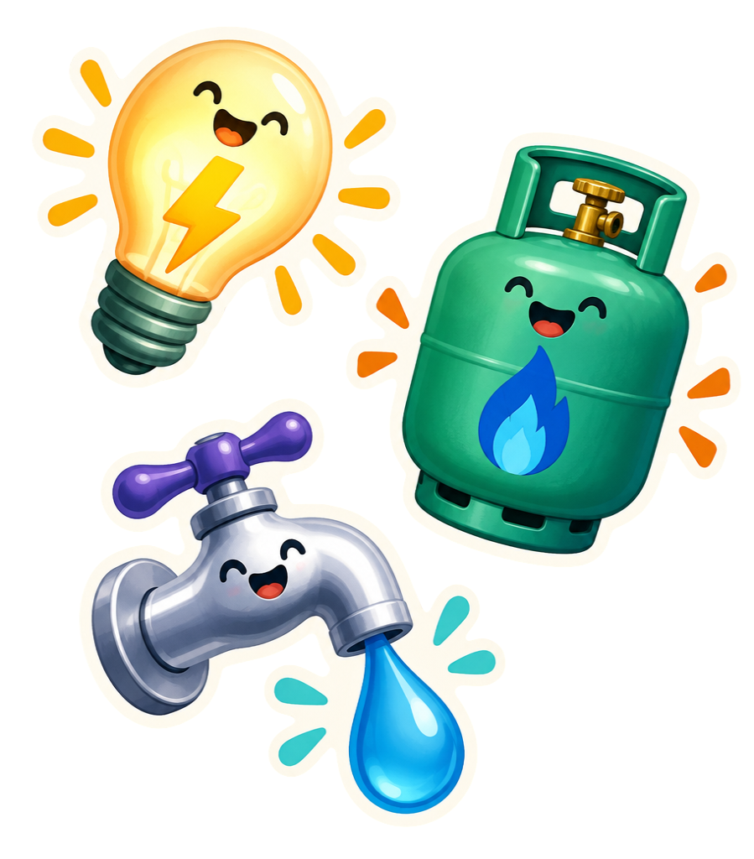
AIML CA2 · PART B
Energy
Consumption
Forecasting
Time Series
Presented by Yan Myoe Naing
AIML CA2 · TIME SERIES
01

Slide 2

DATASET
397 monthly
records
JAN 1990 → JAN 2023
No missing data
DATE parsed as day/month/year index
Goal: 60-month forecasts
GAS tons · ELECTRICITY MWh · WATER tons
AIML CA2 · TIME SERIES
02

Slide 3
PATTERNS · m = 12 MONTHS
Every utility moves
differently.
01
02
03
ELECTRICITY
GAS
WATER
↗ Upward trend + annual cycle
↕ Fluctuating trend + annual cycle
≈ Irregular fluctuations + annual cycle
Multiplicative decomposition
Additive decomposition
Additive decomposition
AIML CA2 · TIME SERIES
03

Slide 4
CHRONOLOGICAL SPLIT
No shuffling. Time stays in order.
TRAIN · 277 MONTHS
VALIDATION · 60
TEST · 60
Jan 1990 — Jan 2013
Feb 2013 — Jan 2018
Feb 2018 — Jan 2023
Training fits the models. Validation supports tuning. The final 60 months form the test period.
AIML CA2 · TIME SERIES
04

Slide 5
ADF STATIONARITY TEST
One series needs
a first difference.
GAS
ELECTRICITY
< 0.0001
0.7664
WATER
ELECTRICITY · Δ
0.0164
1.53×10⁻⁸
Baseline: d=1 electricity · d=0 gas + water
SARIMA: D=1 · m=12
ADF tests a unit root; it does not assess every aspect of stationarity.
AIML CA2 · TIME SERIES
05

Slide 6
MODELLING WORKFLOW
Level → trend → seasonality
SES
Level only
HOLT–WINTERS
Trend + seasonality
SARIMA
Seasonal AR + differencing
HW choices
Electricity: multiplicative trend + additive seasonal
Gas & Water: additive trend + seasonality, m=12
BASELINE SARIMA ORDERS
ELECTRICITY (1,1,1)(1,1,1,12)
GAS (1,0,1)(1,1,1,12)
WATER (2,0,1)(2,1,1,12)
AIML CA2 · TIME SERIES
06

Slide 7
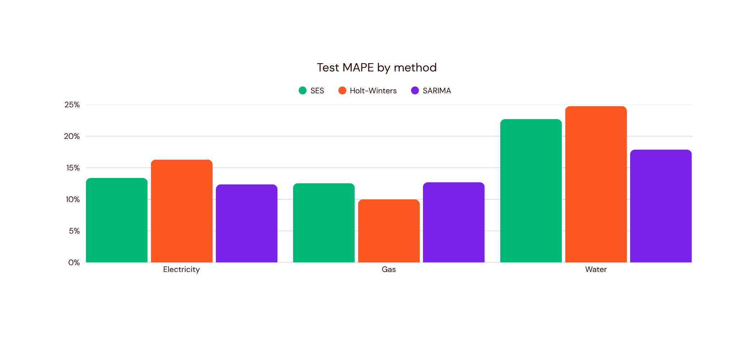
TEST MAPE (%)
Lower is better.
Aligned baseline comparison
AIML CA2 · TIME SERIES
07

Slide 8
HYPERPARAMETER SEARCH
Search wide.
Select on validation.
VALIDATION SCORES — NOT TEST
ELECTRICITY
GAS
WATER
144 searches
81 searches
108 searches
Best validation MAPE 4.03%
Best validation MAPE 21.97%
Best validation MAPE 35.80%
✓ (1,1,0)(3,1,1,12)
✓ (0,1,0)(2,1,0,12)
✓ (3,0,2)(3,1,1,12)
AIML CA2 · TIME SERIES
08

Slide 9
TUNING RESULTS
Model performance after tuning.
Notebook-reported MAPE: Electricity 3.33%, Gas 20.29%, Water 19.97%.
Electricity
SARIMA: 12.35% to 3.33%
Gas / Water
Tuned SARIMA: 20.29% / 19.97%
REPORTED MAPE
Gas Holt–Winters: 9.98%
Water baseline SARIMA: 17.87%
Tuning helps electricity in the reported results.
Gas and water retain other models.
AIML CA2 · TIME SERIES
09

Slide 10

ELECTRICITY · FEB 2023 — JAN 2028
Seasonal growth,
with wide uncertainty.
Full-history SARIMA (1,1,0)(3,1,1,12)
1175.0
1401.9
Mean 994.4 → 1401.9 MWh
95% model envelope 663.4 → 1870.0 MWh
FIRST · MWh
LAST · MWh
Envelope extremes occur on different dates.
AIML CA2 · TIME SERIES
10

Slide 11
60-MONTH FORECASTS
Two utilities. Two uncertainty stories.
GAS · ADDITIVE HW, m=12
WATER · SARIMA (2,1,1)(2,1,1,12)
30.4
33.6
400.9
498.9
FIRST · tons
LAST · tons
FIRST · tons
LAST · tons
Mean 29.8—33.6 tons
Band 22.9—40.6 tons
Mean 400.9—575.7 tons
95% envelope 195.3—842.2 tons
Residual ±1.96 SD heuristic; constant width 13.9. Not a calibrated horizon-specific interval.
The interval range summarises the full 60-month forecast.
AIML CA2 · TIME SERIES
11

Slide 12

CONCLUSION
Seasonal models.
Different utility patterns.
NOTEBOOK MODEL CHOICES
FORECAST INSIGHTS
Electricity: upward trend and annual cycle
Gas: mild growth with seasonal variation
Water: variable usage and wide uncertainty
ELECTRICITY · TUNED SARIMA
GAS · HOLT–WINTERS
WATER · BASELINE SARIMA
The models use the full history to forecast the next 60 months.
AIML CA2 · TIME SERIES
12

